Slide 1


eO-BMS
Web-Based System

Slide 2

eOcambo Technology started in 2014 with a youth generation.
Is a leading local company based in Siem Reap, Cambodia.
We offering the best online solutions focused on the Hospitality Industry.
Hotel Link Solutions is an eOcambo Technology integrated Online Product.

Slide 3





WHAT
WHO
WHY
HOW

Slide 4
eO-BMS is an integrated online management system for Business or Companies that provides a proven way to track your time, manage your work and have your projects succeed.
With its clean and modern design, eO-BMS can help you look more professional to your customers and help improve business performance at the same time.
What is eO-BMS?
We Believed in Data Not in emotion
When coming up to run the business

Slide 5
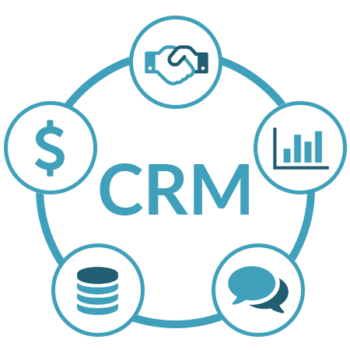
How eO-BMS provides?
Customer Relation Management
Centralizes all customer information their profiles and purchasing history
Customize Customer Profiles
History of Customer Purchases
Centralized Customer Communication
Assign related task to specific staff
History of Customer Projects
Customer Documentation
Converts Lead to Customer
Manage Contracts

Slide 6

How eO-BMS provides?
Project Management
Overview invoice and payment projects
Track Project Performance
Generates follow-ups on the due date
Assign multiple tasks to multiple staff members
Track expenses and time spent on tasks
Bill your customers
Allow checklist
Project Documentation
Highlight Project Priority

Slide 7

How eO-BMS provides?
Sale & Marketing
Complete Sales Process Managed
Generates follow-ups on the due date
Create good looking proposals for leads or customers and increase sales
Create Quotation with a minute
Manage Contracts
Allow Goal Setup
Use the Goals Tracking feature to keep sales goals in mind (KPI)

Slide 8

How eO-BMS provides?
Task & Performance
Assign task to multiple employees
Setup goals and tracking achievements
Make meaningful sense out of where time is going
Understanding which projects are taking your time
Allow Task Checklist
Link tasks to many features and stay organized
Manage Budget setup and actual
Setup S.O.P step and comparing via KPI

Slide 9

How eO-BMS provides?
Human Resource
Customize Employee Profiles
Add knowledge base articles
Allow Cash Advance Request
Allow Payroll Request by month
Leave Setup by year
Leave Application

Slide 10

How eO-BMS provides?
Finance
Record Company Expenses
One click Invoice and Receive Payments
Allow Employee Payroll

Slide 11

How eO-BMS provides?
Report
Sale Report (Invoices, Proposals, Quotations)
Employee Report (Employee, Project, Task)
Summary Chart of Account Report

Slide 12

How eO-BMS provides?
Security
High levels of Data Protection through cloud-based storage
External and User security through individual password access to data
No local back-up needed as data is stored in cloud and cant be lost.
Hacking and Virus threats minimized

Slide 13

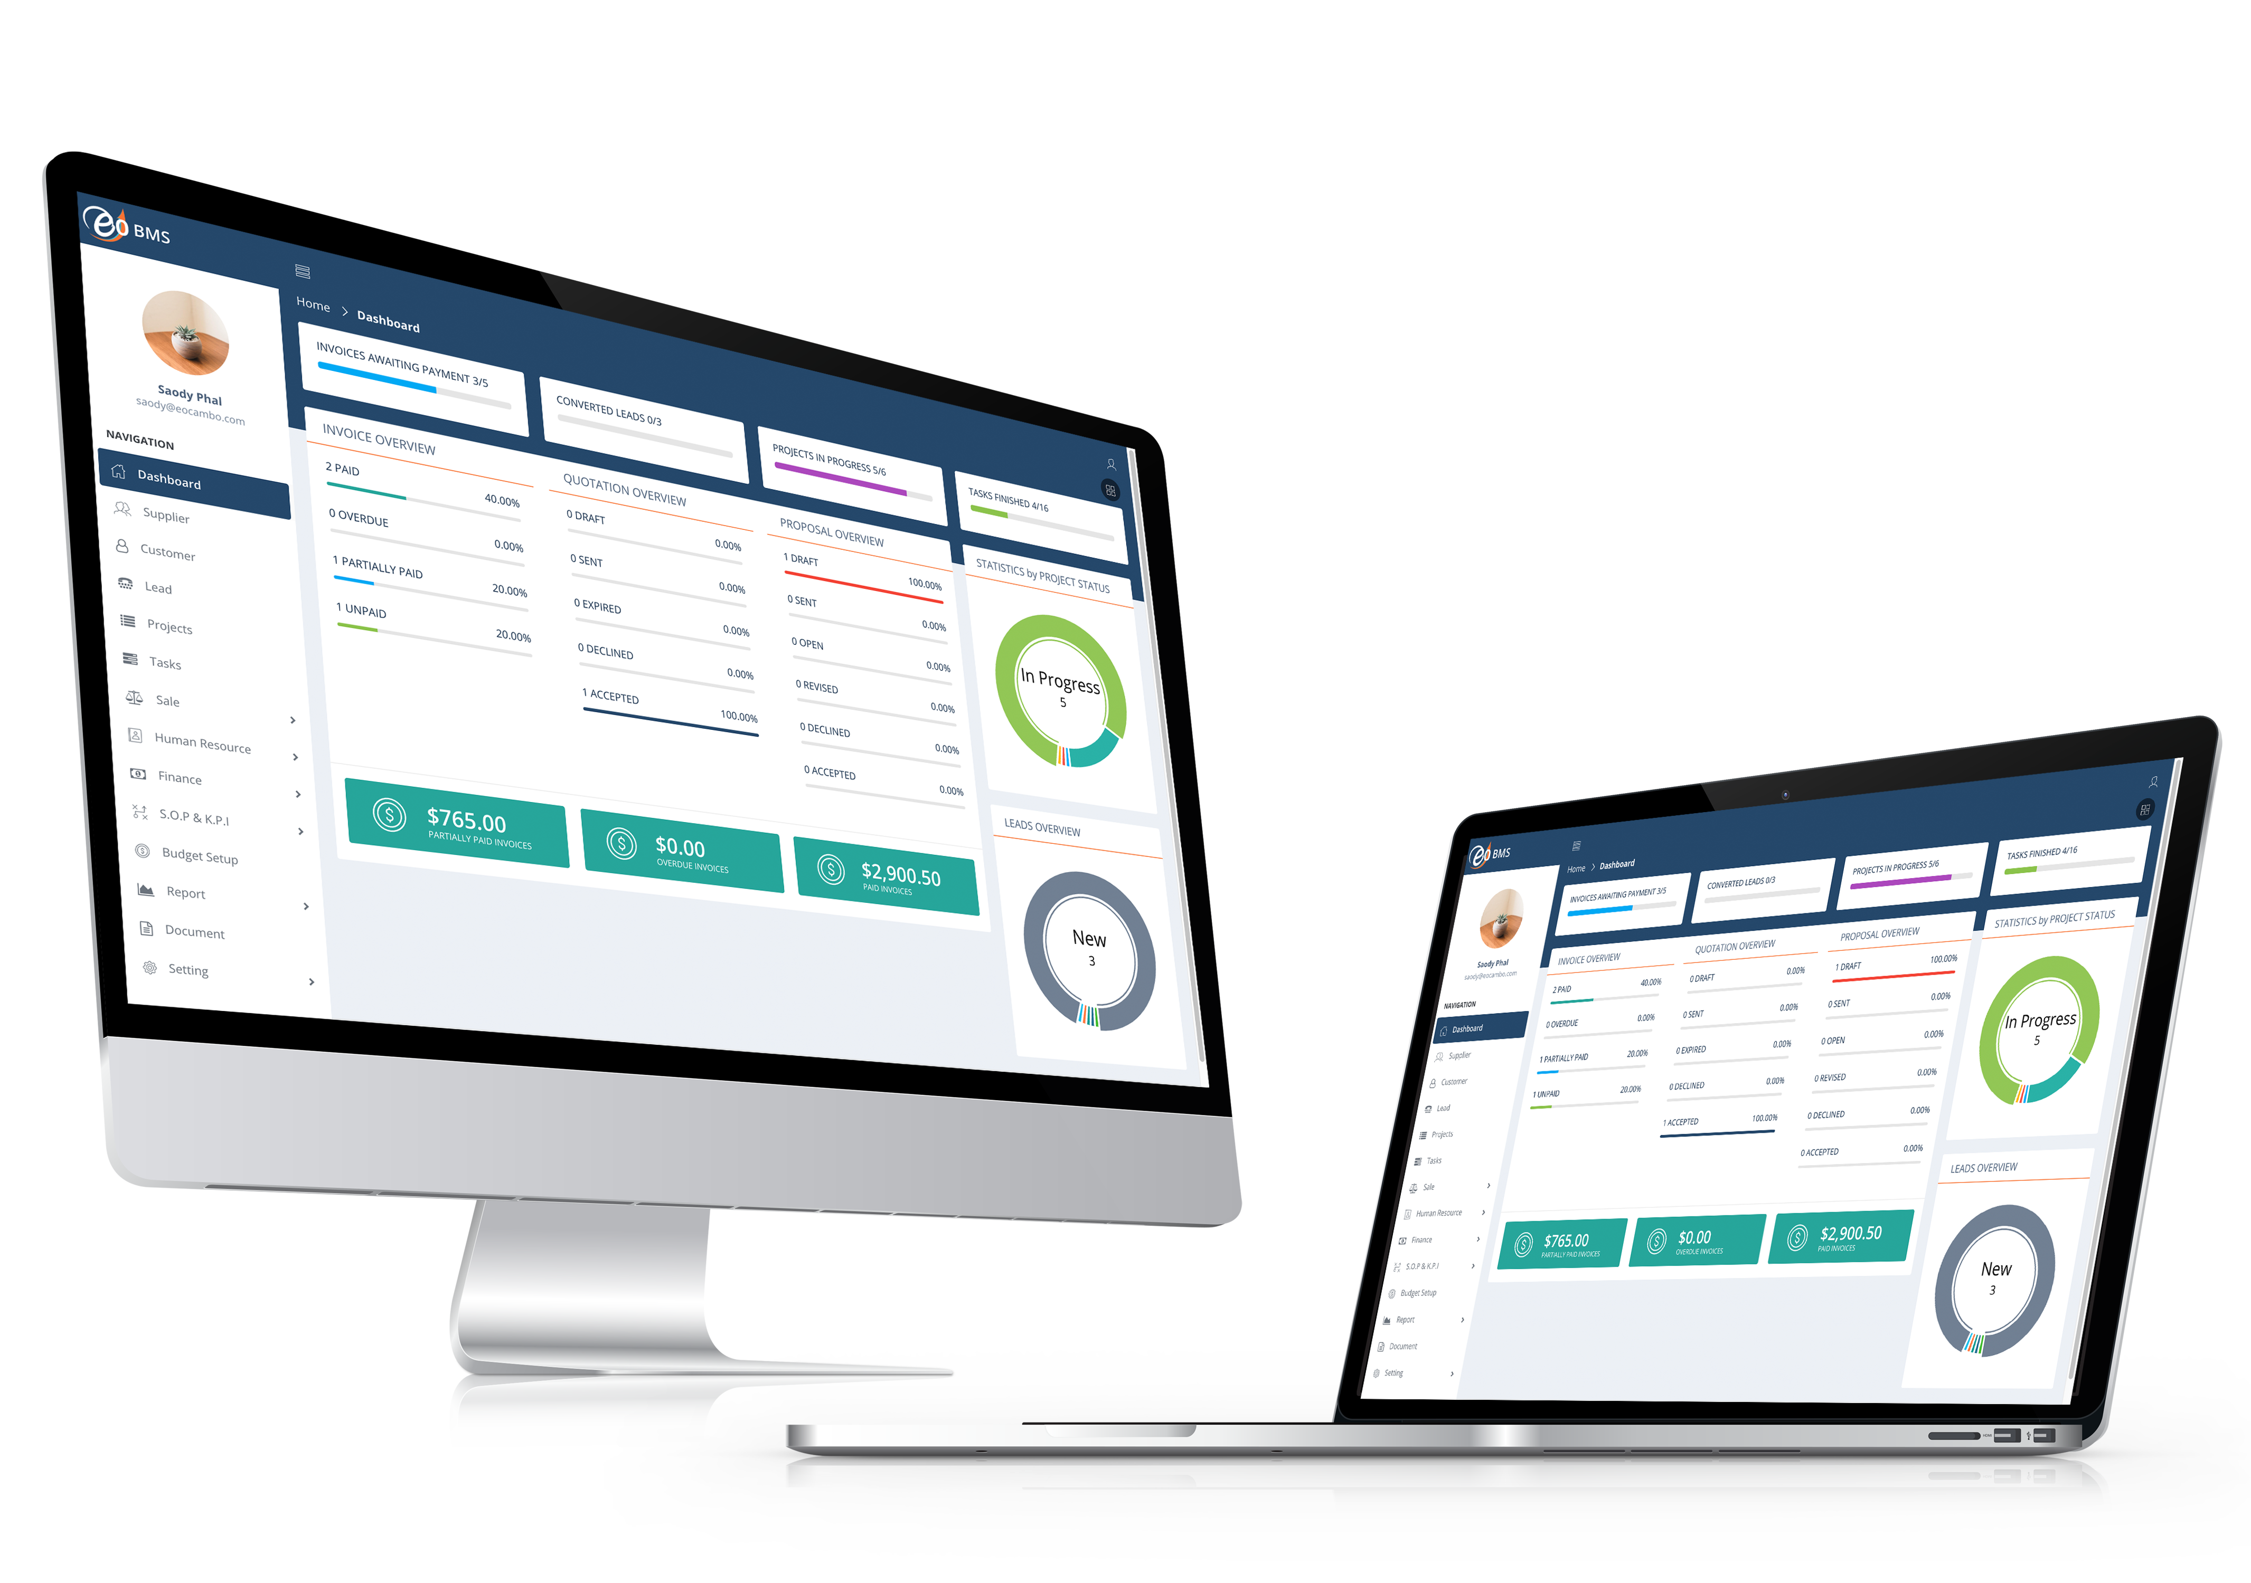
HOW eO-BMS WILL BENEFIT YOUR BUSINESS
Upgrade to modern business
Save Time and Money
Improves Staff Productivity
Automate and Centralize your Business
Track Financial Performance Anytime
Business and Customer Data Security

Slide 14

Thank You

